Slide 1

The Viscosity

Slide 2
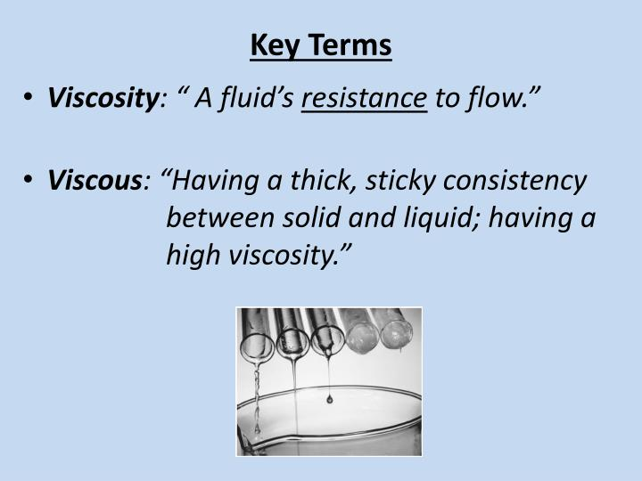

Slide 3
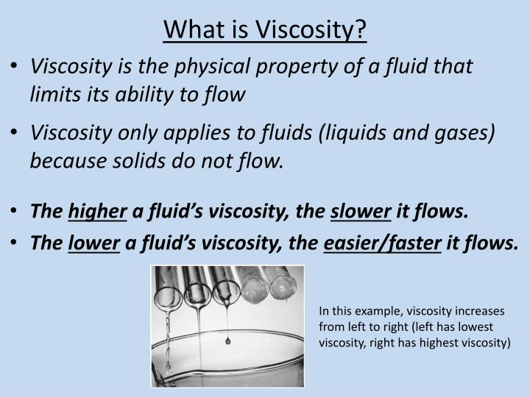

Slide 4
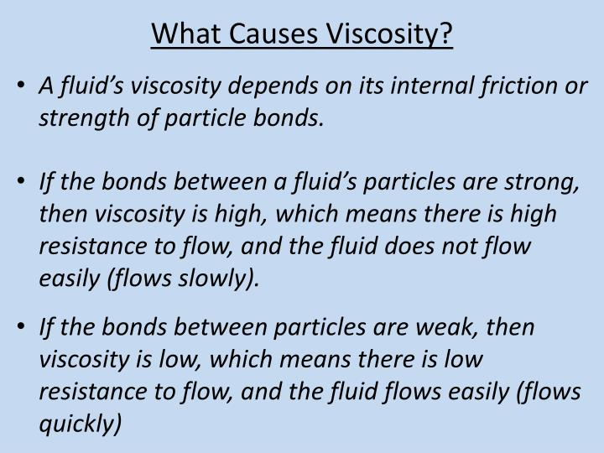

Slide 5
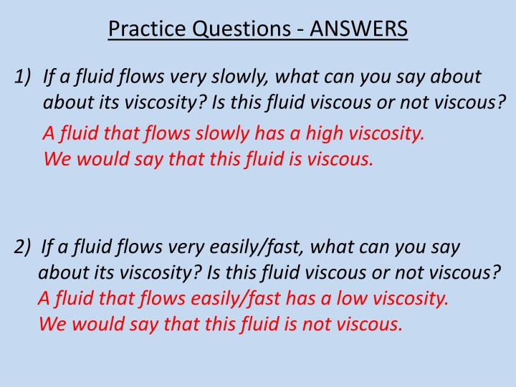

Slide 6
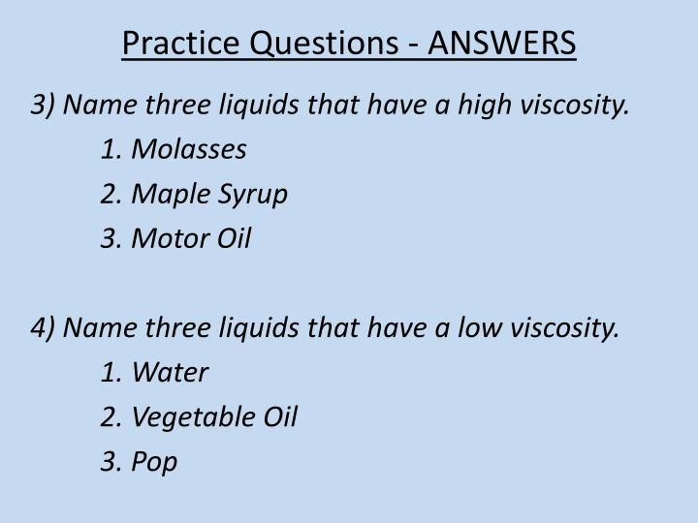

Slide 7
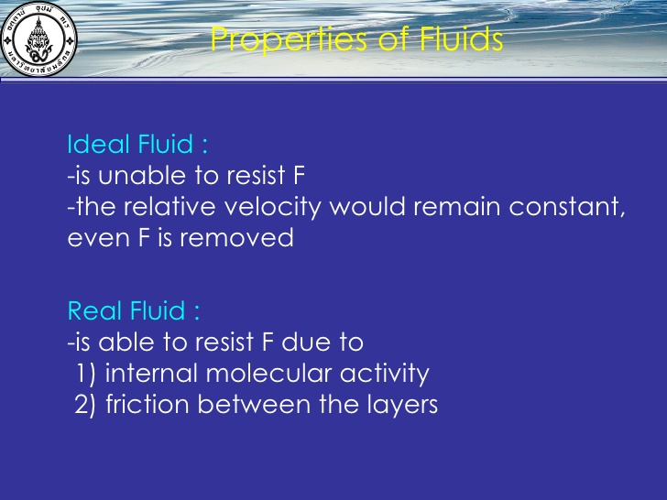

Slide 8
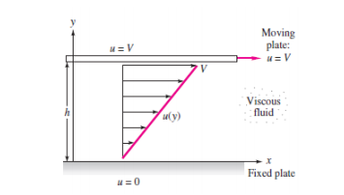

Slide 9

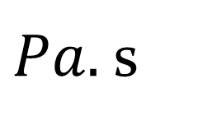
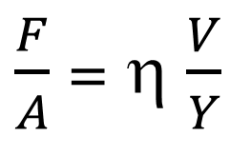

The force may be expressed:
$\frac{F}{A}$ = η $\frac{V}{Y}$
The force ( F ) per unit area ( A ) is proportional to the velocity ( V ) in the distance ( Y ) ; the constant of proportionally is called the viscosity of the fluid.
(η)
$$=\frac{F . Y}{A . V}$$
$$Pa.\frac{m}{m/s}$$
$Pa.$ s

Slide 10
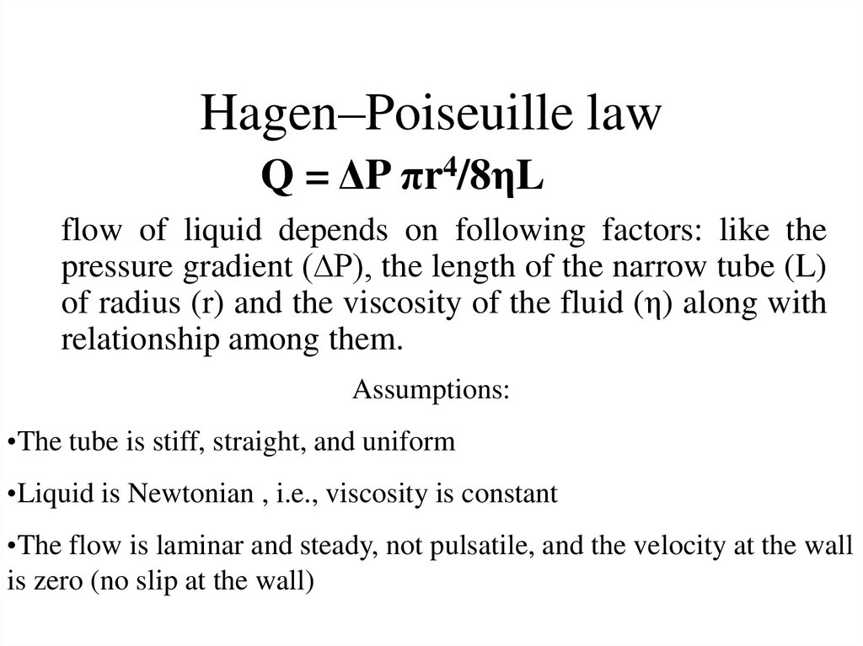

Slide 11
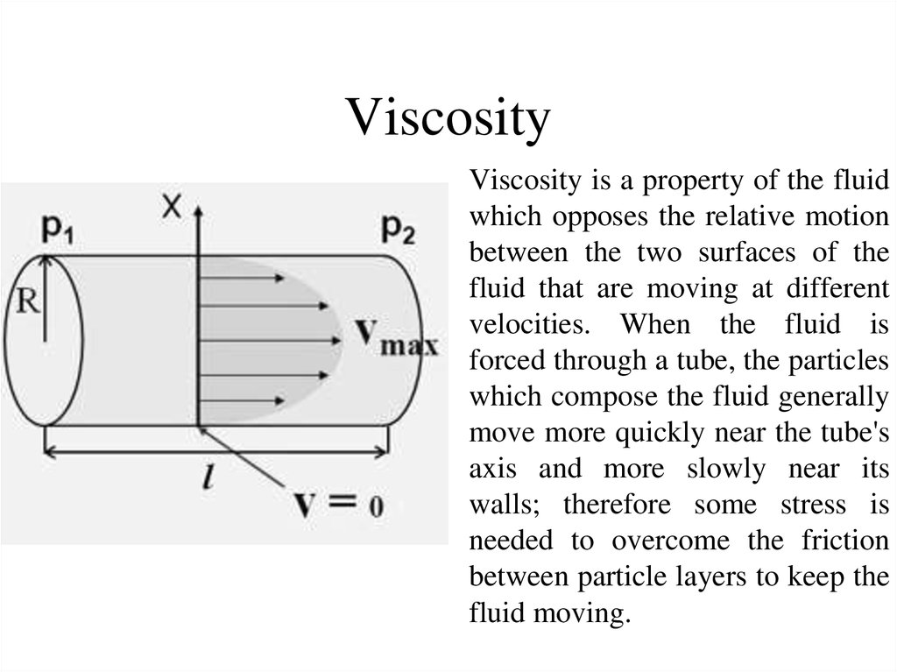
Y

Slide 12
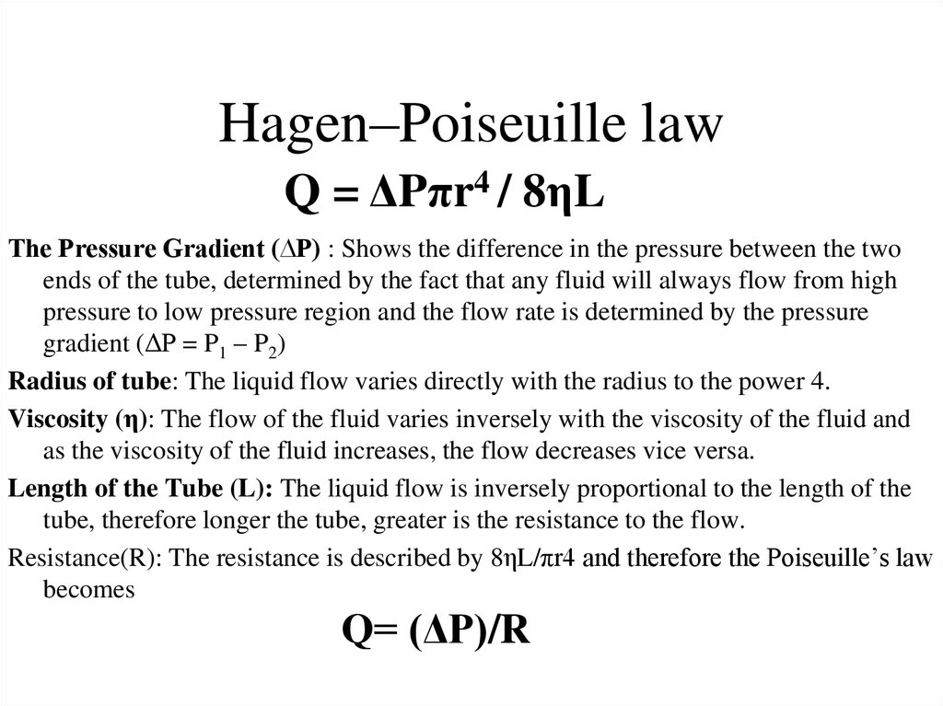

Slide 13
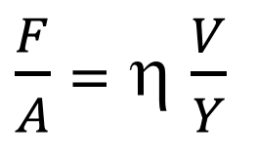
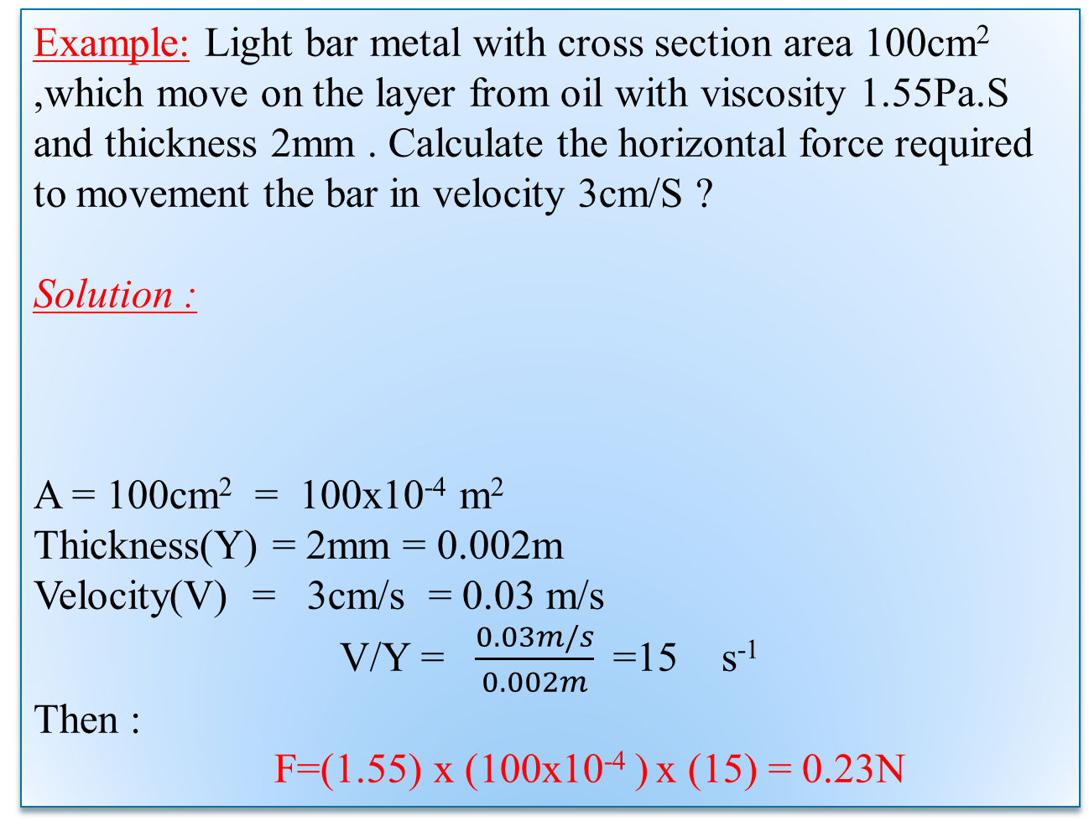
Example: Light bar metal with cross section area 100cm² ,which move on the layer from oil with viscosity 1.55Pa.S and thickness 2mm . Calculate the horizontal force required to movement the bar in velocity 3cm/S ?
Solution :
A = 100cm² = 100x10⁻⁴ m²
Thickness(Y) = 2mm = 0.002m
Velocity(V) = 3cm/s = 0.03 m/s
V/Y = $\frac{0.03m/s}{0.002m}$=15 s⁻¹
Then :
F=(1.55) x (100x10⁻⁴ ) x (15) = 0.23N
$\frac{F}{A}$ = η $\frac{V}{Y}$

